Slide 1
CHAPTER 4
SWAP CONTRACTS, PRICING AND APPLICATIONS

Slide 2
Outline
Nature of swaps
Interest rate swaps
Mechanics of interest rate swap
Typical uses of an interest rate swap
The comparative-advantage argument
Valuation of interest rate swaps
III. Currency swaps
Mechanics of currency swaps
Typical uses of a currency swap
The comparative-advantage argument
Valuation of currency swaps

Slide 3
NATURE OF SWAPS
A swap is an agreement between two companies to exchange cash flows in the future.
The agreement defines the dates when the cash flows are to be paid and the way in which they are to be calculated.
Usually the calculation of the cash flows involves the future value of an interest rate, an exchange rate or other market variable.
Two popular swaps: plain vanilla interest rate swaps and fixed-to-fixed currency swaps.

Slide 4
Mechanics of interest rate swaps (a)
The most common type is a plain vanilla interest rate swap.
A company agrees to pay cash flows equal to interest at a predetermined fixed rate on a notional principal for a number of years. In return, it receives interest at a floating rate on the same notional principal for the same period of time.
The floating rate in most interest rate swaps is the London Interbank Offered Rate (LIBOR).

Slide 5
Example
Consider a hypothetical three-year swap initiated on March 8, 2017, between Apple and Citigroup.
Apple agrees to pay to Citigroup an interest rate of 3% per annum on a notional principal of $100 million, and in return Citigroup agrees to pay Apple the six-month LIBOR rate on the same notional principal. Apple is the fixed rate payer; Citigroup is the floating-rate payer.
The agreement specifies that payments are to be exchanged every six months and that the 3% interest rate is quoted with semiannual compounding.

Slide 7
Mechanics of interest rate swaps (b)
The principal is used only for the calculation of interest payments. The principal itself is not exchanged. → The notional principal.
The floating rate is set 6 months before it is paid. The floating rate is the LIBOR rate prevailing 6 months prior to the time when it is paid.
An interest rate swap is generally structured so that one side remits the difference between the two payments to the other side.

Slide 8
Typical Uses of an Interest Rate Swap
Converting a liability from
fixed rate to floating rate
floating rate to fixed rate
Converting an investment from
fixed rate to floating rate
floating rate to fixed rate

Slide 9
Transforming a liability - Example (a)
Suppose that Apple has arranged to borrow $100 million for three years at LIBOR plus 10 basis points. (One basis point is 0.01%, so the rate is LIBOR plus 0.1%.) After Apple has entered into the swap, it has three sets of cash flows::
1. It pays LIBOR plus 0.1% to its outside lenders.
2. It receives LIBOR under the terms of the swap.
3. It pays 3% under the terms of the swap.
→ Transform borrowings at a floating rate of LIBOR plus 10 basis points into borrowings at a fixed rate of 3.1%.

Slide 10
Transforming a liability – Example (b)
Intel has borrowed $100 million at 3.2% for three years and wishes to switch to a floating rate linked to LIBOR. Like Apple it contacts Citigroup. We assume that it agrees to enter into the swap shown in Figure 7.3. It pays LIBOR and receives 2.97%..

Slide 11
Transforming an asset – Example (a)
Suppose that Apple owns $100 million in bonds that will provide interest at 2.7% per annum over the next three years. After Apple has entered into the swap in Fig 7.1, it is in the position:
The swap has therefore transformed an asset earning 2.7% into an asset earning LIBOR minus 30 basis points.

Slide 12
Transforming an asset – Example (b)
Suppose that Intel has an investment of $100 million that yields LIBOR minus 20 basis points. After it has entered into the swap, it is in the position shown in Figure 7.6.

Slide 13
Role of Financial Intermediary
The regulators in the United States require that standard swaps be traded on electronic platforms. As in other jurisdictions, they must then be cleared through central counterparties (CCPs). The swaps are therefore treated like futures contracts with initial and variation margin being posted by both sides
Apple and Intel are nonfinancial companies. They are using the swaps to mitigate risk, the trades could be entered into directly with Citigroup and cleared bilaterally.
Citigroup is a market maker in interest rate swaps. It has built a three-basis-point spread into the rates at which it transacts. This spread is to compensate it for its overheads and for potential losses in the event of a default by a counterparty.

Slide 14
Quotes By a Swap Market Maker

Slide 15
The Nature of Swap Rates
Six-month LIBOR is a short-term AA borrowing rate
The 5-year swap rate has a risk corresponding to the situation where 10 six-month loans are made to AA borrowers at LIBOR
This is because the lender can enter into a swap where income from the LIBOR loans is exchanged for the 5-year swap rate

Slide 16
Using Swap Rates to Bootstrap the LIBOR/Swap Zero Curve
Consider a new swap where the fixed rate is the swap rate
When principals are added to both sides on the final payment date the swap is the exchange of a fixed rate bond for a floating rate bond
The floating-rate rate bond is worth par. The swap is worth zero. The fixed-rate bond must therefore also be worth par
This shows that swap rates define par yield bonds that can be used to bootstrap the LIBOR (or LIBOR/swap) zero curve

Slide 17
Using Swap Rates to Bootstrap the LIBOR/Swap Zero Curve
Suppose that the 6-month 12-month and 18-month LIBOR/swap zero rates have been determined as 4%, 4,5% and 4,8% with continuous compounding and that the 2-year swap rate (for a swap where payments are made semiannually) is 5%. Compute 2-year LIBOR/swap zero rate.

Slide 18
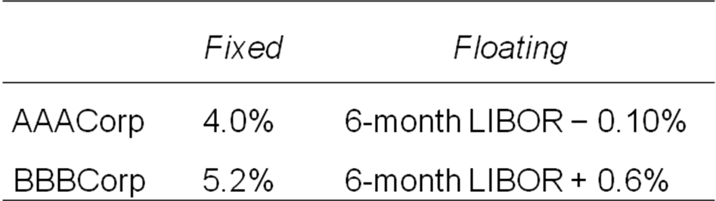
The comparative-advantage argument (a)
Two companies AAA & BBB want to borrow $10 million for 5 years and have been offered the following rates.
Assume that AAA wants to borrow at a floating rate of interest. BBB wants to borrow at a fixed rate of interest.

Slide 19
The comparative-advantage argument (b)
AAA borrows fixed rate funds at 4% per annum. BBB borrows floating-rate funds at LIBOR+0.6% per annum.
Consider an interest rate swap: AAA agrees to pay BBB interest at 6-month LIBOR on $10 billion. In return, BBB agrees to pay AAA interest at a fixed rate of 4.35% per annum on $10 million.

Slide 20
The comparative-advantage argument (c)
AAA has three sets of cash flows:
- It pays 4.0% per annum to the bank
- It receives 4.35 % per annum from BBB
- It pays LIBOR to BBB.
Totally, AAA pays LIBOR-0.35%, 0.25% lower than the floating rate offered by the bank.

Slide 21
The comparative-advantage argument (d)
BBB has three sets of cash flows:
- It pays LIBOR +0.6% to the bank.
- It receives LIBOR from AAA
- It pays 4.35% to AAA
Totally, BBB pays 4.95% per annum, 0.25% lower than the fixed rate offered by the bank.

Slide 22
The Swap
4.35%
4%
AAACorp
BBBCorp
LIBOR+0.6%
LIBOR

Slide 23
The Swap when a Financial Institution is Involved
4.33%
4.37%
4%
AAA
F.I.
BBB
LIBOR+0.6%
LIBOR
LIBOR

Slide 24
The Swap when a Financial Institution is Involved
5.30%
5.40%
5%
A
F.I.
B
LIBOR+0.6%
LIBOR
LIBOR

Slide 25
Problems
Companies A and B have been offered the following rates per annum on a $20 million 5-year loan:
Company A requires a floating-rate loan, company B requires a fixed-rate loan. Design a swap that will net a bank, acting as intermediary, 0.1% per annum and that will appear equally attractive to both companies.
 | Fixed rate | Floating rate
Company A Company B | 5.0% 6.4% | LIBOR + 0.1% LIBOR + 0.6%

Slide 26
2. Companies X and Y have been offered the following rates per annum on a $5 million 10-year investment
Company X requires a fixed-rate investment; company Y requires a floating-rate investment. Design a swap that will net a bank, acting as intermediary, 0.2% per annum and will appear equally attractive to X and Y.
 | Fixed rate | Floating rate
Company X Company Y | 8% 8.8% | LIBOR LIBOR

Slide 27
Valuation of interest rate swaps
An interest rate swap is worth zero or close to zero, when it is first initiated. After it has been in existence, due to the variation of the market rate, its value may become positive or negative.
Two ways to valuate an interest rate swap.
- Interest rate swaps can be valued as a portfolio of forward rate agreements (FRAs)
- Interest rate swaps can be valued as the difference between the value of a fixed-rate bond and the value of a floating-rate bond.

Slide 28
Example
Suppose that some time ago a financial institution entered into a swap where it agreed to make semiannual payments at a rate of 3% per annum and receive LIBOR on a notional principal of $100 million. The swap now has a remaining life of 1.25 years. Payments will therefore be made 0.25, 0.75, and 1.25 years from today. The risk-free rates with continuous compounding for maturities of 3 months, 9 months, and 15 months are 2.8%, 3.2%, and 3.4%. The LIBOR rate applicable to the exchange in 0.25 years was determined 0.25 years ago. Suppose it is 2.9% with semiannual compounding.

Slide 29
Example
The forward LIBOR rates for the 3- to 9-month and the 9- to 15-month periods are 3.4% and 3.7%, respectively, with continuous compounding.
The 3- to 9-month forward rate becomes 3.429% with semiannual compounding. The 9- to 15-month forward rate becomes 3.734% with semiannual compounding.

Slide 30
The value of the floating-rate payer
The value of the fixed-rate payer
V_{swap} =value of the swap
B_{fix} = value of the fixed-rate bond
B_{fl} = value of the floating-rate bond

Slide 31
The value of the fixed-rate bond:
t_{i} = the time at which interest payments are exchanged.
L= Notional principal
r_{i} = LIBOR (discount rate) for a maturity of t_{i}
k = the fixed interest payment

Slide 32
The value of the floating-rate bond
The bond is worth the notional principal immediately after an interest payment, because:
- Immediately after an interest payment, the floating-rate bond is quite similar to a newly issued floating-rate bond.
- The value of a newly issued floating-rate bond that pays 6-month LIBOR is always equal to its principal value when the LIBOR curve is used for discounting.

Slide 33
The next exchange of payment is at time t1. The floating payment that will be made at time t1 (which was determined at the last payment date) is k*. The value of the floating-rate bond at time t1:
The current value of the floating-rate bond:

Slide 34
Example:
A financial institution has agreed to pay 6-month LIBOR and receive 8% per annum (with semiannual compounding) on a notional principal of $100 million.
The swap has a remaining life of 1.25 years. The LIBOR rates with continuous compounding for 3-month, 9-month and 15-month maturities are 10%, 10.5% and 11%, respectively. The 6-month LIBOR rate at the last payment date was 10.2% (with semiannual compounding).
Calculate the value of the swap from the position of the institution.

Slide 35
Problems
3. A $100 million interest rate swap has a remaining life of 10 months. Under the term of the swap, 6-month LIBOR is exchanged for 7% per annum (compounded semiannually). The average of the bid-offer rate being exchanged for 6-month LIBOR in swaps of all maturities is currently at 5% per annum with continuous compounding. The 6-month LIBOR rate was 4.6% per annum 2 months ago. What is the current value of the swap to the party paying floating? What is its value to the party paying fixed?

Slide 36
Currency swaps-mechanics
A currency swap involves exchanging principal and interest payments in one currency for principal and interest payments in another. In a currency swap the principal is usually exchanged at the beginning and the end of the swap’s life.
Usually the principal amounts are chosen to be approximately equivalent using the exchange rate at the swap’s initiation. When they are exchanged at the end of the life of the swap, their values may be quite different.

Slide 37
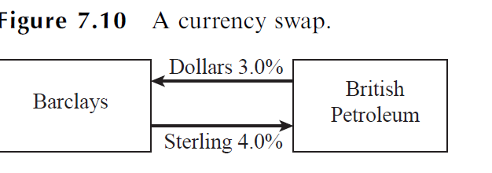
An Example of a Currency Swap
Consider a hypothetical five-year currency swap agreement between British Petroleum and Barclays entered into on February 1, 2017. British Petroleum pays a fixed rate of interest of 3% in dollars to Barclays and receives a fixed rate of interest of 4% in British pounds (sterling) from Barclays.
Interest rate payments are made once a year and the principal amounts are $15 million and £10 million.

Slide 39
Typical Uses of a Currency Swap
Conversion from a liability in one currency to a liability in another currency
Conversion from an investment in one currency to an investment in another currency

Slide 40
Example:
Suppose that British Petroleum can borrow £10 million at 4% interest. The swap has the effect of transforming this loan into one where it has borrowed $15 million at 3% interest.
Suppose that British Petroleum can invest $15 million to earn 3% in U.S. dollars for the next five years, but feels that sterling will strengthen (or at least not depreciate) against the dollar and prefers a U.K.-denominated investment. The swap has the effect of transforming the U.S. investment into a £10 million investment in the U.K. yielding 4%.

Slide 41
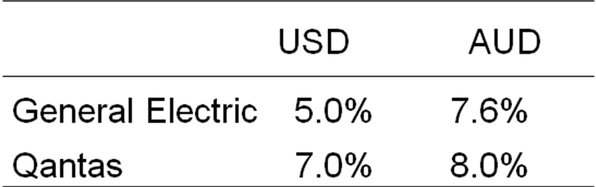
Comparative Advantage Arguments for Currency Swaps
Example: The 5-year fixed-rate borrowing costs to GE and Qantas Airways in USD and AUD:

Slide 42
GE wants to borrow 20 million AUD and Qantas Airways wants to borrow 15 million USD. The current exchange rate:
1 AUD=0.75 USD.
GE borrows USD, whereas Qantas borrows AUD. Then, they use a currency swap to transform GE’s loan into an AUD loan and Qantas’s loan into a USD loan.

Slide 43
Problems
4. Company X wishes to borrow US dollars at a fixed rate of interest. Company Y wishes to borrow Japanese Yen at a fixed rate of interest. The amounts required by the two companies are roughly the same at the current exchange rate. The companies are subject to the following interest rates:
Design a swap that will net a bank, acting as intermediary, 50 basis points per annum. Make the swap equally attractive to the two companies and ensure that all foreign exchange risk is assumed by the bank.
 | JPY | USD
Company X Company Y | 5.0% 6.5% | 9.6% 10.0%
Notes:
Hãy xây dựng một hợp đồng hoán đổi với sự tham gia của 1 trung gian tài chính, thu phí 50 điểm cơ bản/năm, sao cho cả 2 công ty đều tiết kiệm được khoản lãi suất ngang nhau?
Giải: Chênh lệch lãi suất JPY: 1.5%, chênh lệch lãi suất USD 0.4% → Có thể tiết kiệm được 1.1% nhờ hợp đồng hoán đổi tiền tệ. Trung gian tài chính thu phí 0.5% (50 điểm cơ bản) → Tiết kiệm được 0.6% , mỗi bên tiết kiệm được 0.3%, khiến công ty X có thể vay được USD với lãi suất 9.3%, công ty Y vay được JPY với lãi suất 6.2%.
0.01% = 1 điểm cơ bản

Slide 44
5. Companies A and B face the following interest rates:
Suppose company A wants to borrow USD at a floating rate of interest and B wants to borrow CAD at a fixed rate of interest. A financial institution is planning to arrange a swap and requires a 50-basis-point spread. If the swap is to appear equally attractive to A and B, what rates of interest will A and B end up paying?
 | Company A | Company B
USD CAD | LIBOR + 0.5% 5.0% | LIBOR + 1.0% 6.5%

Slide 45
Valuation of currency swaps - Example:
Suppose that the term structure of risk-free interest rates is flat in both Japan and the United States. The Japanese rate is 1.5% per annum and the U.S. rate is 2.5% per annum (both with continuous compounding). A financial institution has entered into a currency swap in which it receives 3% per annum in yen and pays 4% per annum in dollars once a year. The principals in the two currencies are $10 million and 1,200 million yen. The swap will last for another three years, and the current exchange rate is 110 yen per dollar.
Calculate the value of the swap to the institution.

Slide 46
Valuation in Terms of Bond Prices
The value of a swap in USD where
+ US dollars are received and a foreign currency is paid:
+ the foreign currency is received and dollars are paid:
B_{D} =value of the bond measured in USD.
B_{F} =value of the bond measured in the foreign currency.
S₀ = the spot exchange rate

Slide 47
Problem
6. A currency swap has a remaining life of 15 months. It involves exchanging interest at 10% on £20 million for interest at 6% on $30 million once a year. The term structure of interest rate in both the UK and the US is currently flat, and if the swap were negotiated today the interest rates exchanged would be 4% in dollars and 7% in sterling. All interest rates are quoted with annual compounding. The current exchange rate (dollars per pound sterling) is 1.85000. What is the value of the swap to the party paying sterling? What is the value of the swap to the party paying dollars?

